Slide 1
TOPIC
SLA-based Scheduling of Spark Jobs in Hybrid Cloud Computing Environments
SUBMITTED BY
ATHIRA T
VDA20MCA-2022
UNDER GUIDANCE OF
MS.DILNA V G

Slide 2
ABSTRACT
ANALYSING data at a massive scale is becoming crucial due to the availability of huge data in various domains such as scientific research, social media, business.
Big data frameworks such as Apache Spark , Hadoop and storm is becoming prominent to perform large-scale data analytics jobs.
However, due to limited resource availability, the local or on-premise computing resources are often not sufficient to run these jobs.
Therefore, public cloud resources can be hired on a pay-per-use basis from the cloud service providers to deploy a Spark cluster entirely on the cloud.
Nevertheless, using only cloud resources can be costly.
Hence, both local and cloud resources nowadays are used together to deploy a hybrid cloud computing cluster.

Slide 3
Service-Level Agreement (SLA) demands such as cost minimization and job deadline guarantee.
Most of the existing works either consider a public or a locally deployed cluster and mainly focus on improving job performance in the cluster.
In this paper, we propose efficient scheduling algorithms that leverage from different VM instance pricing in a hybrid cloud deployed cluster to optimize the Virtual Machine (VM) usage cost for both local and cloud resources and maximize the job deadline met percentage.
We have conducted extensive simulation-based experiments to compare our proposed algorithms with the baseline approaches.
In addition, we have developed a prototype system on top of Apache Mesos cluster manager and performed real experiments to evaluate the applicability of our proposed approaches in a real platform with benchmark applications.
The results show that our proposed algorithms are highly scalable and reduce the cost of VM usage of a hybrid cluster for up to 20%.

Slide 4
INTRODUCTION
We have chosen Apache Spark as our target big data processing platform as it is vastly replacing traditional Hadoop-based platforms.
Spark can utilize memory to store intermediate results to speed up the processing.
Moreover, it is more scalable than other platforms and more suitable for running complex analytics jobs.
Spark programs can be written in many high-level programming languages, and it also supports diverse data sources such as HDFS , Hbase , Cassandra and Amazon .
The data abstraction of Spark is called Resilient Distributed Dataset (RDD) which is fault-tolerant.
When a Spark job is launched, it creates one or more executors that use a fixed chunk of resources in any cluster nodes.

Slide 5
These executors are used by a job to run multiple tasks in parallel at different stages of the data processing pipeline to work on various partitions of the dataset.
The default scheduler of Spark is FIFO , which schedules the jobs on a first-come-first-serve basis.
We propose scheduling algorithms that work on the cluster-scheduling level, and utilize the pricing of different VM instance types in a hybrid cloud to effectively handle the following challenges:
• Performing cluster-level scheduling to make finegrained decisions for executor placements on a hybrid cloud environment.
• Minimizing the deadline violations for the jobs in the cluster.
• Minimizing the monetary cost of using the Virtual Machines (VMs) of the whole cluster.

Slide 6
LITERATURE REVIEW
There is some existing research for SLA-based job scheduling, which only focuses on Hadoop MapReducebased jobs.
Hwang proposed a resource provisioning model that can minimize the VM cost for deadlineconstrained MapReduce applications in cloud.
Mashayekhy proposed a greedy algorithm that finds the assignments of the map and the reduce tasks in machine slots to minimize the energy consumption of a Hadoop cluster.
Nayak proposed a negotiation-based adaptive scheduler for scheduling Hadoop jobs in cloud.
Cheng have considered future resource availability to improve job performance and reduce job deadline violations.
Zeng proposed a greedy algorithm that reduces the monetary cost of using the public cloud while satisfying job deadlines.

Slide 7
However, most of these works either consider a single cluster setup or tries to improve job performance.
Moreover, these approaches are applicable to Hadoop jobs only as the architecture paradigm of Hadoop is different from Spark.
Sparrowtried to improve the performance of the default Spark scheduling by using a decentralized, randomized sampling ased scheduler.
Maroulis provided an energy-efficient scheduler that uses the DVFS technique to tune the CPU frequencies for the workloads to reduce energy consumption.
However, as our main target is costeffectiveness, this approach can not be applied to ou problem. Li also provided an energy-efficient scheduler.
In summary, most of the existing approaches focus mainly on performance improvement.
In contrast, our approach guarantees to launch a job on its required resources, tries to minimize deadline violations, can handle different sizes of executors of jobs and different VM instance sizes, and can reduce the overall cost of VM usage of a hybrid cloud deployed cluster by utilizing different pricing.

Slide 8
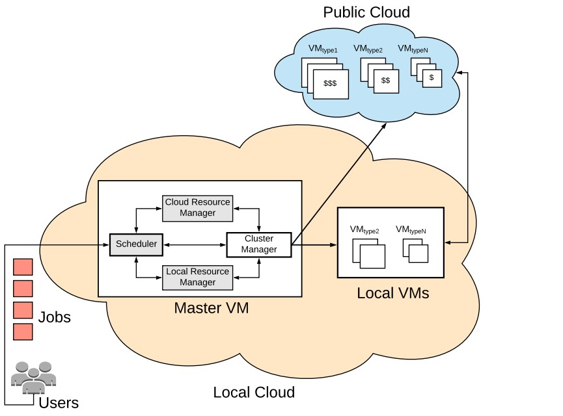
PROPOSED METHEDOLOGY
We describe the hybrid cloud model and formulate the problem of dynamic job scheduling between local VMs and cloud VMs.
In our proposed model, the scheduler uses a queue which follows the EDF (earliest deadline first) order of jobs, to reduce deadline violations.
The scheduler iterates over each job, dynamically observes the latest cluster resource availability, and makes scheduling decisions to place the executors for that job.
For simplicity, we present the model on a per-job basis, which means the model represents what the scheduler observes for making decisions for the next job in the scheduling queue.
In the following subsections we model the cost and resource constraints for both local and cloud VMs.

Slide 9
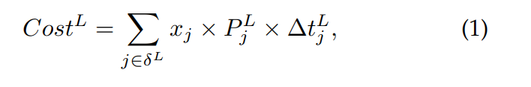
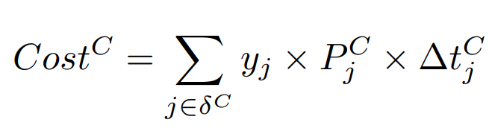
Local Resource Model
Definition-1 (Local VM Set):
Consider a set δ L = {1, 2, · · · , M}, where M is the total number of local VMs, 1 ≤ j ≤ M is the j th VM deployed locally. The expression of local cost for the current job, J is derived as follows:
where P L j is the unit price for a local VM.
∆t L j is the change in the remaining active time for a local VM j
we define a binary decision variable xj to indicate whether a local VM is active or not
Cloud Resource Model
Definition-2 (Cloud VM Set):
Consider a set δ C = {1, 2, · · · , N}, where N is the total number of cloud VMs, 1 ≤ j ≤ N is the j th VM deployed on the cloud. Similarly, the expression of cloud cost for the current job, J is derived as follows:
where P C j is the unit price for a cloud VM.
we define a binary decision variable yj to indicate whether a cloud VM is active or not
∆t C j is the change in the remaining active time for a cloud VM if any executor of the current job is placed in it

Slide 10
Based on the system model, we now formulate the job scheduling problem to minimize the cost of using the whole cluster while scheduling the current job.
The total cost is modeled as the aggregated cost of using all the VMs from both local and cloud
Therefore, the job scheduling problem can be formulated as
Cost-Min: min : Costtotal = CostL + CostC ,
The above problem is mixed-integer linear programming (MILP) and non-convex generally known as NPhard problem .
The computational complexity will significantly increase due to the binary variables.

Slide 11
PROPOSED JOB SCHEDULING ALGORITHMS
First Fit (FF) Heuristic-based Algorithm
In the bin packing problem, items of different volumes must be packed into a finite number of bins or containers each of a fixed given volume in a way that minimizes the number of bins used.
In our case, we have a similar problem where the executors can be considered as the items which need to be packed into a finite number of VMs (bins).
Thus, the scheduling problem formulated can be thought of as a two-dimensional (2D) vector bin packing
Each executor from a job has a fixed resource requirement in these two dimensions; thus, an executor can be thought of as an item.
Therefore, the objective is to minimize the total number of bins (VMs) used to pack (place) a given set of items (executors) for each job.

Slide 12
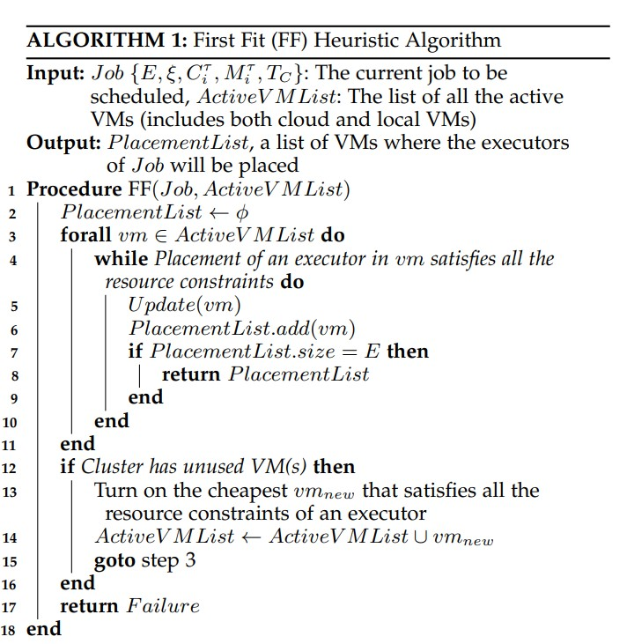

Slide 13
The input to this algorithm is the specification of the current job (E, ξ, Cτ i , Mτ i , TC ) to be scheduled, and a list of currently active VMs (either in local or cloud) in the cluster.
The output is the PlacementList, which is a list of VMs where the executors of the current job should be placed.
For each active VM, the algorithm first checks whether the placement of an executor of the current job will satisfy the resource constraints (lines 3-4).
If so, the resource capacity of the current VM is updated (line 5), and the current VM is added to the PlacementList.
The algorithm tries to place as many executors as possible in the same VM if the resource requirements are met.
Otherwise, it tries the next active VM.
If the total number of added VMs to the PlacementList reaches the total required number of executors for the current job, the algorithm returns with the placement list.
If the currently active VMs are not sufficient to place any executor, then the cheapest VM is turned on (if available) and is added to the active VM list (lines 12- 14).
Then, steps 3-10 are repeated again.
If the cluster does not have sufficient resources to place all the executors of the current job, the algorithm returns failure (line 17).

Slide 14
PROPOSED JOB SCHEDULING Algorithm
Greedy Iterative Optimization (GIO) Algorithm
The aforementioned MILP problem can be solved in polynomial time if the problem is relaxed from a per-job basis (finding the most cost-optimal placements of all the executors of the current job) to a per-executor basis (only find the most cost-effective placement of one executor from the current job).
Although solving the relaxed problem will provide near-optimal results as compared to the original problem, it can be solved in polynomial time.
We propose a greedy iterative optimization (GIO) algorithm, which utilizes the pricing model of different VM instances and the estimated completion time of each job to find cost-efficient executor placement (on a per-executor basis)

Slide 15
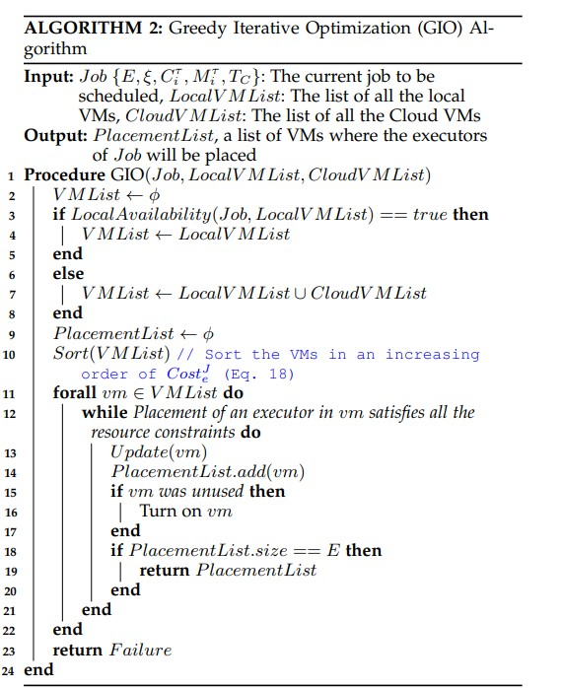

Slide 16
The input to this algorithm is the current job to be scheduled, and a list of all the local VMs, and the list of all the cloud VMs.
The output is the PlacementList, which is a list of VMs where the executors of the current job should be placed.
At first, we check whether the current local resource availability is sufficient to place all the executors of the current job (line 3).
If yes, we only utilize the local VMs (line 4), otherwise all the VMs (line 5).
Then, the V MList is sorted in an increasing order of CostJ e values (line 10).
If the resource constraints are met, then the current vm is greedily used to place as many executors as possible (lines 12-14).
If the currently chosen vm was inactive, it is turned on (lines 15-16).
The steps for executor placement are repeated until all the executors of the current job are placed (lines 18-19).
If the cluster does not have sufficient resources to place all the executors for the current job, a failure is returned (line 23).

Slide 17
REAL EXPERIMENTS CONDUCTED
We have developed a prototype system to evaluate the performance of the proposed job scheduling algorithms in a real hybrid cloud setup shows the architecture of the system.
To implement any scheduling policy, the capability of placing an executor in any VM is needed.
Apache Mesos cluster manager provides this functionality by dynamic resource reservations, where any type of resource (e.g., CPU cores or memory) can be reserved in any VM so that only the desired executor can run with the reserved resources.
Mesos provides HTTP APIs to control dynamic resource reservation of a cluster.
Therefore, a scheduler can dynamically place executors in any VM during the scheduling process.
As we have a hybrid cluster comprising of both local and cloud VMs, a Mesos cluster can be set up using these VMs, where each VM works as a Mesos agent.
Here, each Spark executor runs inside a Mesos container in a Mesos agent

Slide 18
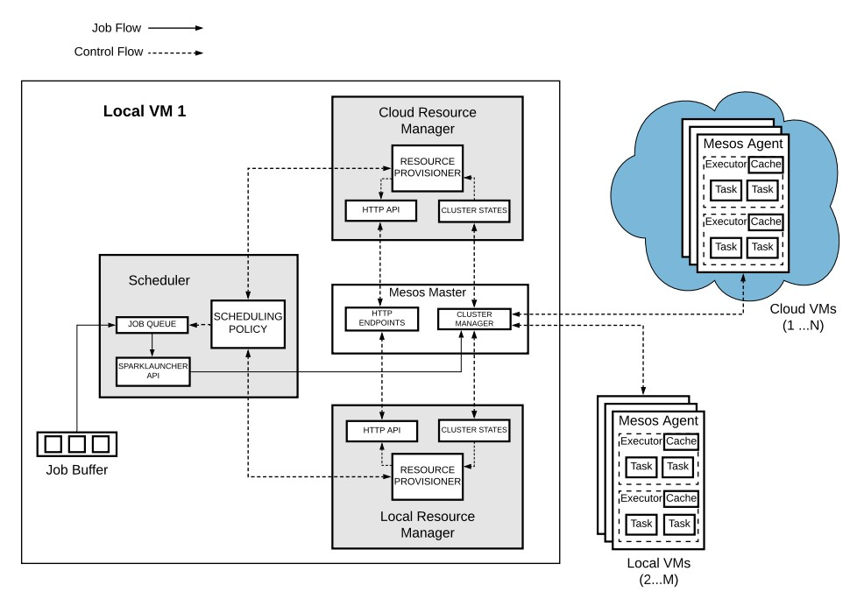
REAL EXPERIMENTS CONDUCTED
System Architecture

Slide 19
As shown in the system architecture, we have implemented three additional modules (grey boxes) that work in collaboration with the Mesos master.
All these modules are deployed into a local VM along with the Mesos master, which works as a central point of control for both the local and cloud VMs.
Thus, from a job’s perspective, there is a single cluster.
However, the local and cloud VMs are deployed in different regions to exhibit a true hybrid cloud setup.
There are two resource managers in the implemented system - Cloud and Local; for managing the VMs.
Each resource manager can communicate with the Mesos master using the HTTP APIs for performing resource provisioning.
Furthermore, resource managers can fetch cluster states (e.g., job and resource status) from the Mesos master.
The developed modules are not extended from the default Spark’s framework scheduler.
Therefore, it is pluggable to the Mesos cluster manager and can be extended to work with any other Mesos-supported big data frameworks.
We have implemented our proposed and baseline scheduling algorithms in the scheduler module. Java programming language was used to implement the proposed modules and scheduling algorithms.

Slide 20
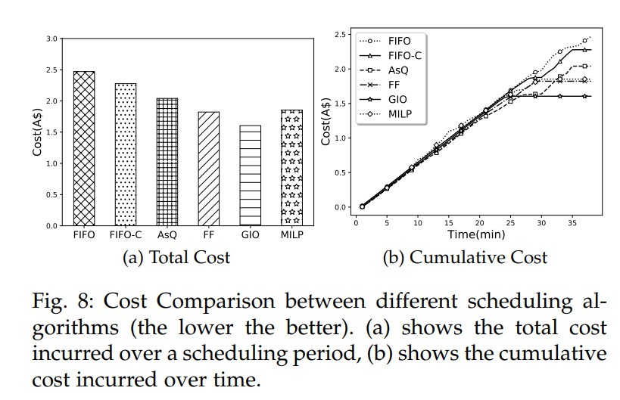
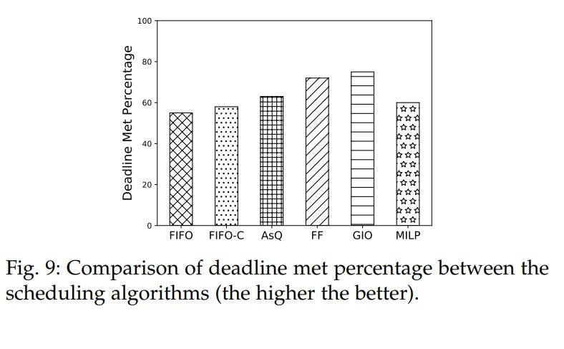
RESULT
Evaluation of Cost Efficiency
Evaluation of Job Deadline

Slide 21
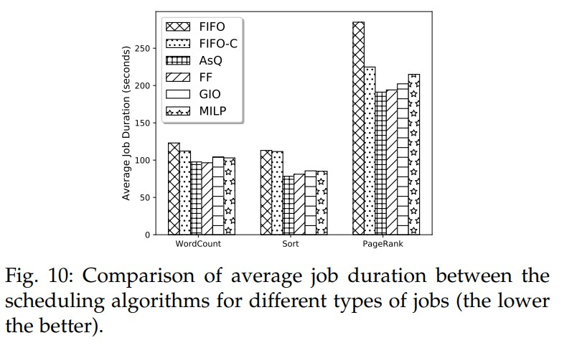
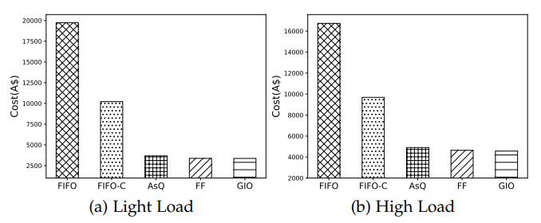
Effects on Job Performance
Evaluation of Scalability

Slide 22
CONCLUSION
In this paper, we have formulated the SLA-based Spark job scheduling problem in a hybrid cloud as an optimization problem.
We have proposed two greedy heuristics-based algorithms to solve the scheduling problem.
Besides, we have implemented the proposed algorithms on top of Apache Mesos to show the applicability in real environments.
We have compared the proposed approaches in both simulated and real experiments to show the superiority of them over the baseline approaches.
The results show that our proposed algorithms can significantly reduce VM usage costs in a hybrid cloud.
Although there are performance overheads due to data transmission delays caused by hybrid placements, it is negligible as compared to the cost-saving benefits.
Moreover, the proposed approaches are highly scalable and have low scheduling ovverhead, which is similar to the native Spark schedulers

Slide 23
REFERENCE
[1] V. K. Vavilapalli, A. C. Murthy, C. Douglas, S. Agarwal, M. Konar, R. Evans, T. Graves, J. Lowe, H. Shah, S. Seth et al., “Apache hadoop yarn: Yet another resource negotiator,” in Proceedings of the 4th ACM Annual Symposium on Cloud Computing, 2013.
[2] M. Zaharia, R. S. Xin, P. Wendell, T. Das, M. Armbrust, A. Dave, X. Meng, J. Rosen, S. Venkataraman, M. J. Franklin, A. Ghodsi, J. Gonzalez, S. Shenker, and I. Stoica, “Apache spark: A unified engine for big data processing,” Communications of the ACM, 2016.
[3] A. Toshniwal, S. Taneja, A. Shukla, K. Ramasamy, J. M. Patel, S. Kulkarni, J. Jackson, K. Gade, M. Fu, J. Donham et al., “Storm at twitter,” in Proceedings of the 2014 ACM SIGMOD international conference on Management of data. ACM, 2014, pp. 147–156.
[4] K. Shvachko, H. Kuang, S. Radia, and R. Chansler, “The hadoop distributed file system,” in Proceedings of the 26th IEEE Symposium on Mass Storage Systems and Technologies (MSST), 2010.
[5] L. George, HBase: the definitive guide: random access to your planetsize data. ” O’Reilly Media, Inc.”, 2011.

Slide 24
THANK YOU

